Slide 1


Cloud Computing Workshop Session 2: Containers
Dimitris Kargatzis
Stelios Sotiriadis

Slide 2
Plan for today
Lecture part 1:
What is DevOps?
What are the best practices for software development?
Lecture part 2:
What is a container?
What are the difference between VMs and Containers?
What is Docker?
Lab session:
Learn Docker
Using Docker to deploy containers

Slide 3
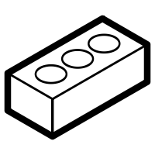

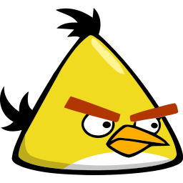
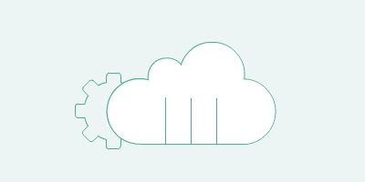
Development and Operations
Your app is buggy!
Deploy my app!
Devs
Ops

Slide 4




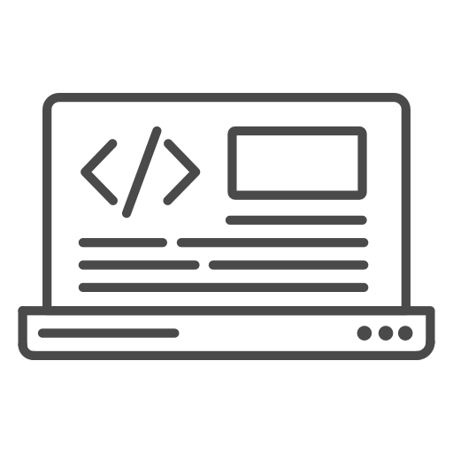

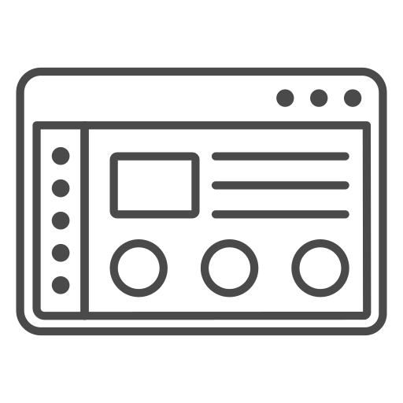
Software Development Models (1)
In waterfall, we develop systematically, from phase to phase in a downward fashion
Suited for smaller projects where requirements are well defined
Devs
Requirements
Ops
Plan
Design
Develop
Test
Release

Slide 5


Software Development Models (2)
Agile adopts iterative development
Each incremental part is developed over an iteration
Each iteration is intended to be small and easily manageable and that can be completed within a couple of weeks only
Each iteration software is developed and deployed to the customers
Requirements
Plan
Release
Design
Devs
Ops
Test
Develop

Slide 6
What is DevOps?
Development and operations are the key two teams that every software development company needs!
Both Devs and Ops teams are composed by highly technical people
Historically communication have been manual and slow
DevOps refers to the merging of roles between Devs and Ops

Slide 7
Devs and Ops roles
Devs develop
Application performance e.g. using cache, databases etc.
End use analytics e.g. user latency
Code quality
Code level errors e.g. fixing bugs
Ops deploy and maintain
Application availability e.g. up and running
Performance, e.g. monitor application CPU usage
End user complaints e.g. fix problems
Performance analytics e.g. alerts and troubleshooting

Slide 8
What is DevOps?
Development and operations are are no longer “siloed.”
These two teams are merged into a single team
The engineers work across the entire application lifecycle, from development and test to deployment to operations, and develop a range of skills not limited to a single function.
The skills we develop in this class
They use a technology stack and tooling which help them operate and evolve applications quickly and reliably.

Slide 9
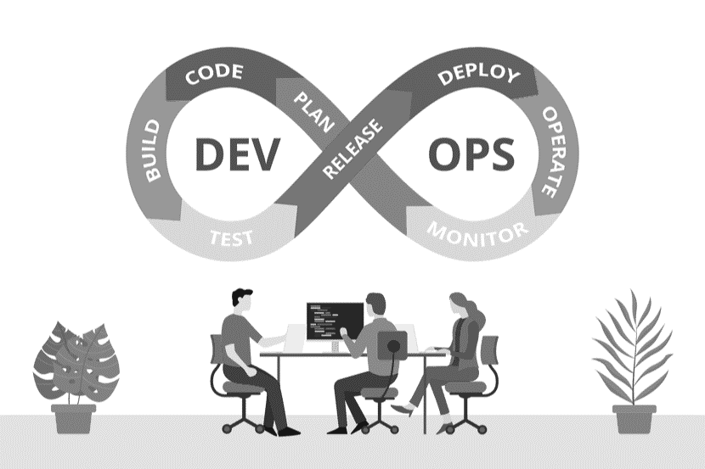
DevOps
DevOps is the combination of cultural philosophies, practices, and tools that increases an organization’s ability to deliver applications and services at high velocity.

Slide 10
Benefits of DevOps
Speed of Development:
Faster software development, teams take ownership of software
Rapid Delivery of Products:
Increase the frequency and pace of releases so you can innovate and improve your product faster.
Reliability of Products:
Use practices like continuous integration and continuous delivery to test functionalities
Scaling and use of Cloud Computing:
Automation and consistency help you manage complex or changing systems efficiently.
Improved Collaboration
Build more effective teams emphasising values such as ownership and accountability.

Slide 11
DevOps key practices
Continuous Integration (CI)
Merging all developers’ working code copies to a shared repo several times a day.
Continuous Delivery (CD)
Teams producing software in short cycles and software can be reliably released at any time

Slide 12
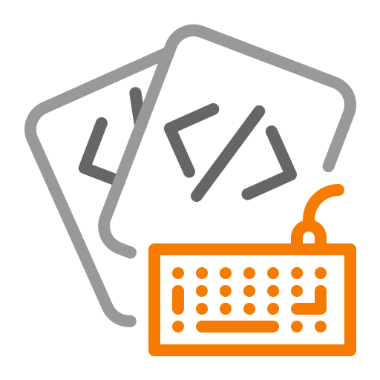





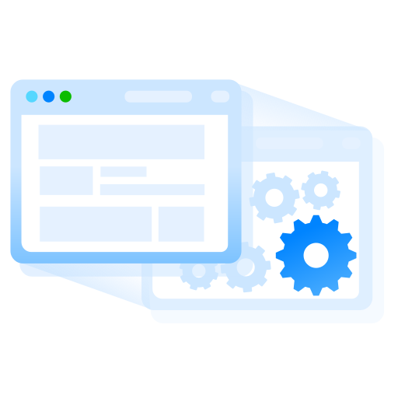



DevOps: from your laptop to production
CD Pipeline
CI Pipeline
Code
Build
Unit Tests
Integration Tests
Review
Staging
Production
Commit

Slide 13
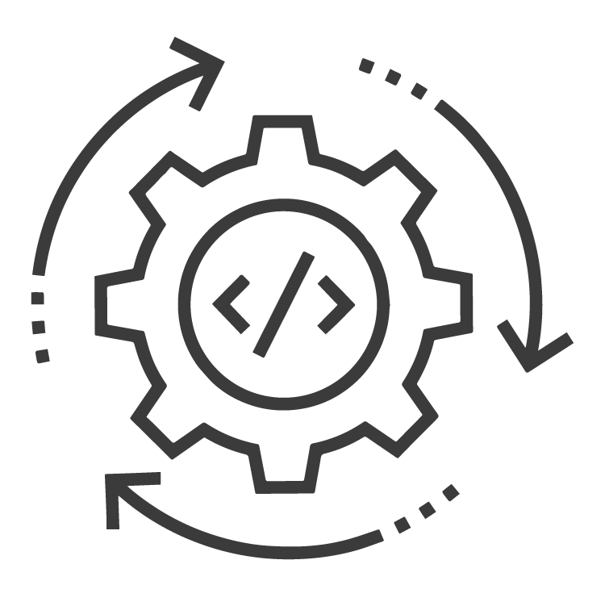
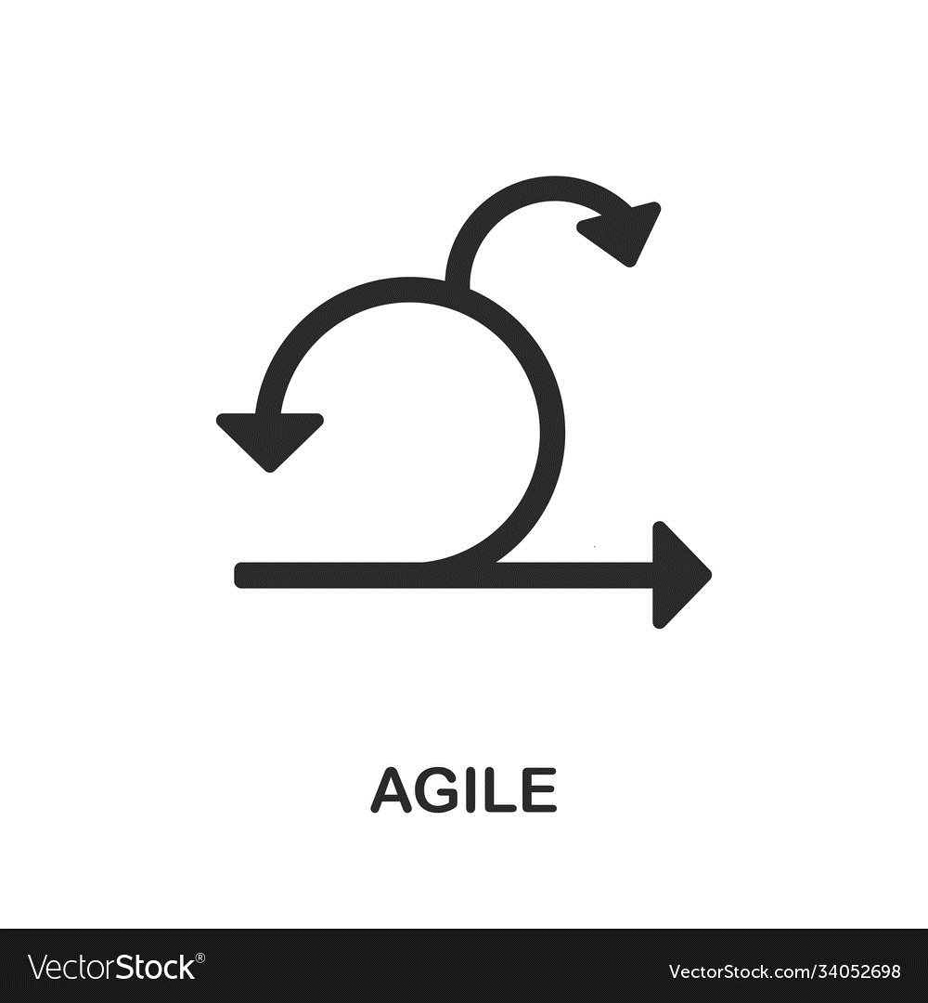
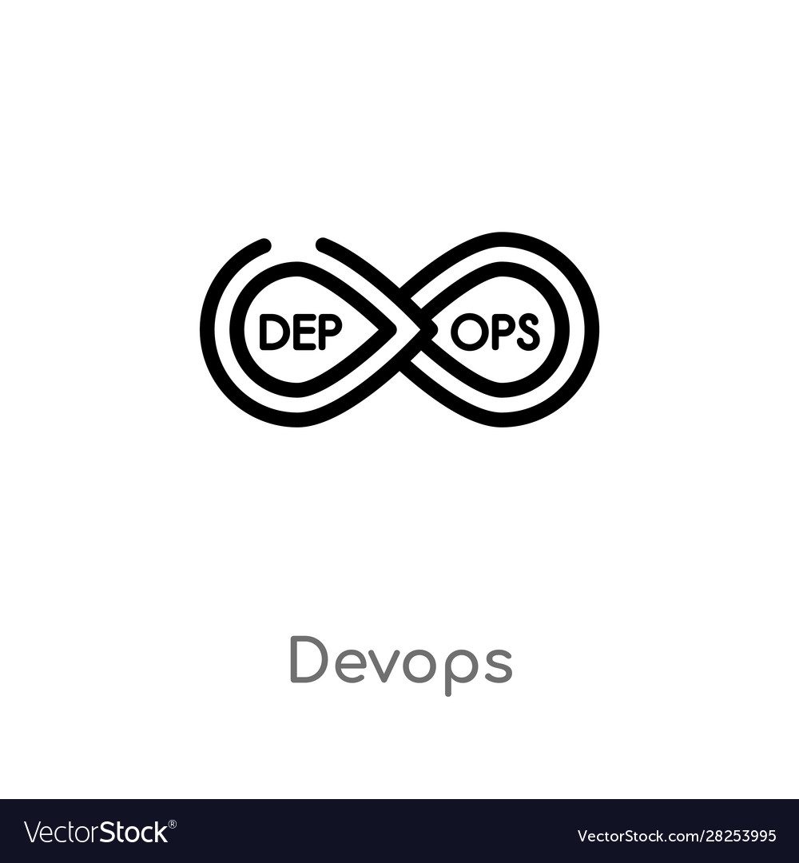
Agile vs CI/CD vs DevOps
Agile
CI/CD
DevOps
focuses on
processes
focuses on
software-defines life cycles
focuses on
culture
highlighting
change
highlighting
tools
highlighting
roles
while accelerating
delivery
while accelerating
automation
while accelerating
responsiveness

Slide 14
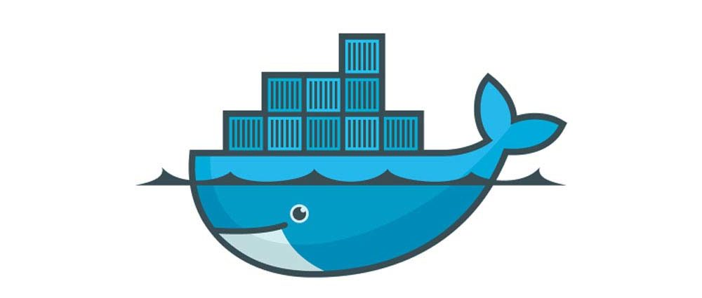
DevOps summary
A way to evolve and improve products taking advantage of modern:
Project management approaches
Agile methods
Software engineering methods
Microservices etc.
Modern systems for CI/CD
More to come soon (Infrastructure as a Code)
What is the enabling technology?
Containers

Slide 15
Application Containerisation

Slide 16
Is there a technology to…
…develop and deploy code and move from your computer to stagging and then to production system, in a fast and efficient manner?
Yes! Let’s use containers!

Slide 17
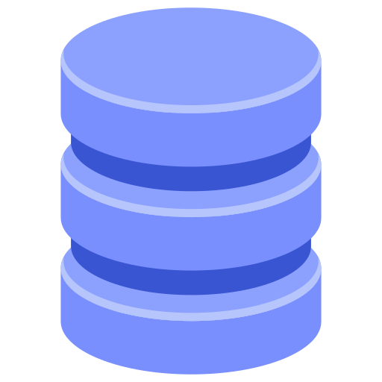
Containers…
The bad old days…
Applications are the heart of a system
If an app breaks, businesses break
One app in one server
Do we need a new app?
We need to buy a new server…
Tragic waste of company capital and environmental resources
User Interface
Application Logic
Data Interface
Data

Slide 18
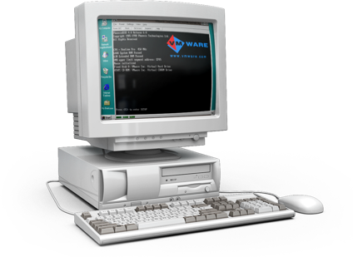
Hello VMWare!
VMWare Inc. gift to the world
VMware presents its first product, Workstation 1.0, at DEMO 1999.
Release of VMware ESXi type-1 hypervisor to deploy virtual computers (March 23, 2001)
Read this → VMWare history
Overnight world changed to a better place!
We could squeeze multiple applications in one server
…the virtual machine ☺

Slide 19
VMs changed IT industry, but …
VMs are far from perfect ☹
Slow to boot, need installation of OS, libraries, too manually tasks…
Migration is a headache
Portability is an issue
*Portability: The ability of software to be transferred from one machine or system to another.

Slide 20

Hello Containers!
Google used containers for years to address the shortcomings of VMs
Containers = VMs – OS
Fast to boot, portable and good for DevOps
Linux containers (LXC):
A Linux container is a set of processes isolated from the system, running from a distinct image that provides all the files necessary to support the processes
Docker:
Magic!
Software that creates, manages and orchestrates containers
Docker Inc. is the company created the technology and solutions

Slide 21
Container?
What is a container?
It is an Operating System virtualisation method to deliver software in packages
Applications are self-contained and easy to move around
Containers are not replacing virtualization!
But, it is an elegant way to deploy applications and services
Easy to distribute applications

Slide 22
So how does this work?
Why do we need containers?
Why containers are ideal for DevOps?
What is Docker?

Slide 23
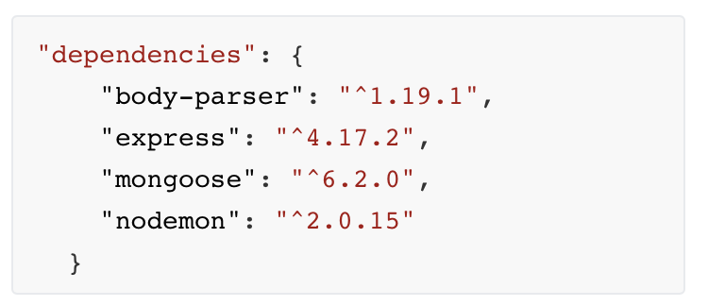

Nick is a software developer…
Nick developed the a MiniPost REST API using Node.js
Nick developed the app in his MacBook using a MongoDB service
Nick used different libraries:
Node.js (v16.13.1)
NPM (v8.1.2)
Mongoose (v6.2)
…
These are called dependecies
The app is ready! It works perfectly!
Nick felt amazing for just a minute, then he felt desperate!
The app is still in his laptop…

Slide 24
Why Nick is in trouble?
Nick developed the app in his laptop, now he has to deploy it in a Cloud server e.g. Google Cloud Platform.
What are the possible problems?
Setup the application again & install software and libraries
What about incompatible libraries?
Nick developed the app in his MacBook…, does it work the same in Ubuntu?
No!!!
Incompatible dependencies
Can we be sure that everything runs?

Slide 25
Todays problem?
How to get software to run reliably when moved from one computing environment to another.
From a developer's laptop to a test environment, from a staging environment into production?
From a physical machine in a datacentre to a virtual machine in a private or public cloud?

Slide 26
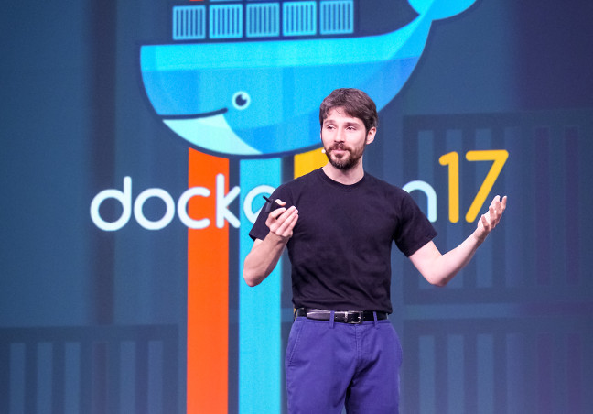
Docker
Docker creator Solomon Hykes.
"You're going to test using Python 2.7, and then it's going to run on Python 3 in production and something weird will happen. You'll run your tests on Debian and production is on Red Hat and all sorts of weird things happen.“
How to solve such problems?
Use Docker!
1200 Docker contributors
100K Dockerized applications
3-4 million devs using Docker
70% of enterprises are using Docker

Slide 27
Containers
What is a container?
A container is a standard unit of software that packages up code and all its dependencies so the application runs quickly and reliably from one computing environment to another.
It is another way to deploy applications
It is ideal for DevOps: CI/CD
Key features of Containers?
AGILITY, PORTABILITY & SCALABILITY

Slide 28
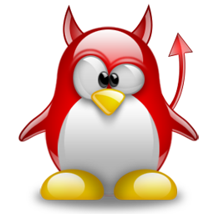
What is a Linux Daemon?
A daemon is a long-running background process that answers requests for services
The term originated with Unix, but most operating systems use daemons in some form or another
In Unix, the names of daemons conventionally end in "d".
Some examples include httpd , nfsd , sshd and other
At a particular instant of time, it can be either running, sleeping, or zombie (a process that completed its task, but waiting for its parent process to accept the return value).

Slide 29
Docker Platform (terminology)
Docker Engine: Open-source containerization technology for building and containerizing your applications.
Docker daemon: The Docker daemon listens for Docker API requests and manages Docker objects such as images, containers, networks, and volumes.
Docker CLI: (command line interface): A command line tool that lets you talk to the Docker daemon
Docker Hub: a service provided by Docker for finding and sharing container images with your teams

Slide 30
The Docker technology
Three key parts:
The runtime: Lowest level, responsible for starting and stopping containers
runc
Interface with the OS to start/stop containers
containerd
Manager container lifecycle (pushing/pulling, networking etc.)
The daemon (engine): Runs and manages images, containers, provides a REST API
The orchestrator: Manages clusters of Docker nodes
These clusters are called swarms (native technology called Docker Swarm)

Slide 31
What about Kubernetes?
Alternative docker orchestrator…
Most people choosing Kubernetes instead of Docker
What is Kubernetes?
Open-source Google project
Today is considered the de facto orchestrator of containerised apps
We will talk about Kubernetes in Bonus class

Slide 32
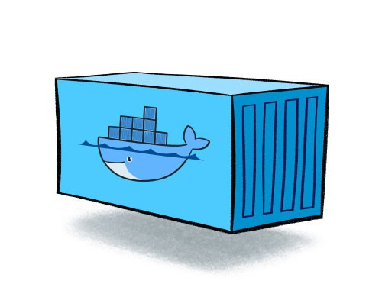
Containers: Key features?
Portability
Ability to move applications and data from one system to another with minimal disruption
Scalability
Ability of a system resources to grow to accommodate demand
Availability
Ability of a system or system component to be continuously operational

Slide 33
Why to use containers?
Agile development
Deliver value to customers faster
Scalable systems
Containers are easy to scale
Cost optimization (more cheap)
Pack a lot of containers in the same environment (e.g. a VM)
Portability:
Develop in one your laptop, deploy anywhere

Slide 34
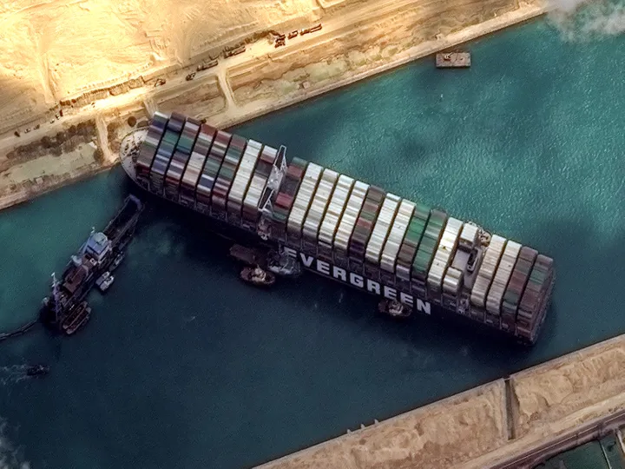
Container’s cons
Containers consume resources more efficiently than VMs
But containers are still subject to performance overhead due to overlay networking, interfacing between containers and the host system and so on.
Persistent data storage is complicated.
By design, all the data inside a container disappears forever when the container shuts down, unless you save it somewhere else first.

Slide 35
VMs and Containers
Containers do not replace VMs
They do different things
Use containers when you want to have data and application that is easy to move
Container can run inside VMs
Or, you can deploy directly on a server
Usually, we run containers inside VMs

Slide 36
Virtualization vs Containerization
VM 1
VM 2
VM 3
App₁
App₂
App₃
Container 1
Container 2
App₄
App₅
App₆
Bins/Libs
Bins/Libs
Bins/Libs
Bins/Libs
Bins/Libs
Guest OS
Guest OS
Guest OS
Docker daemon
Docker
Hypervisor (type 2)
Host OS
Host OS
Server
Server
Containers
VMs

Slide 37
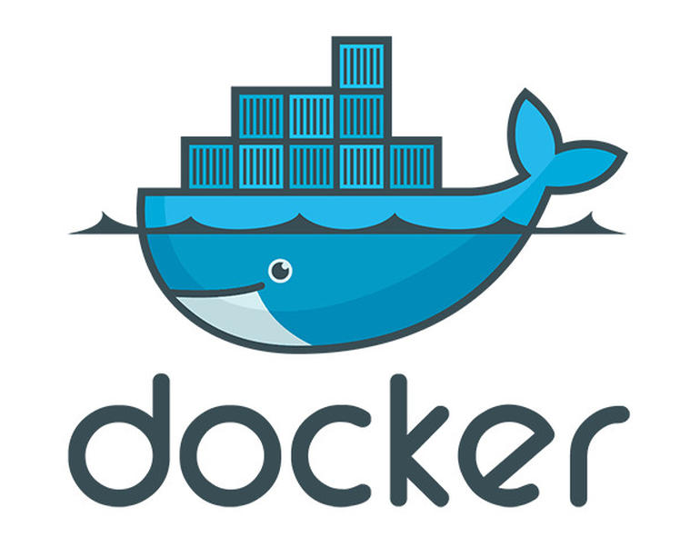
Container technology
Docker is the largest player
Released as open source in 2013
Leading container ecosystem
Raised $190M in past years
Currently most popular container technology…
Orchestration frameworks:
Kubernetes and Mesos
Proprietary systems

Slide 38



Docker images vs Docker Container
Docker image
A Docker image is a read-only template that contains a set of instructions for creating a container.
It provides a convenient way to package up applications/configurations.
Docker container
A Docker container image is a lightweight, standalone, executable package of software that includes everything needed to run an application: code, runtime, system tools, system libraries and settings.
Containers are running instances of an image

Slide 39
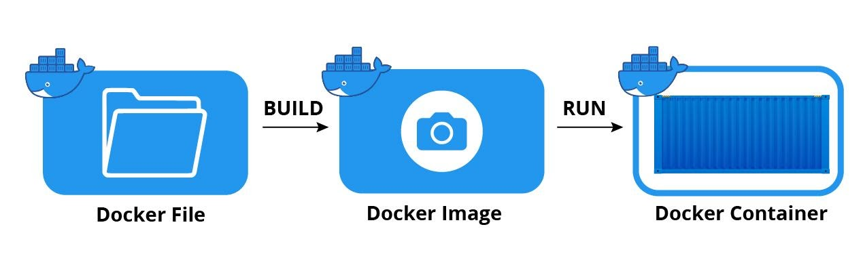



Docker: Building and running an app
Builds
Runs
Dockerfile
Docker image
Docker container
A document containing all the commands to create an image, e.g. install node.js, express, your code etc.
A read-only template that packages up your code and preconfigured environments e.g., node.js
A running instance of your image including: code, runtime, system tools, system libraries and settings.

Slide 40
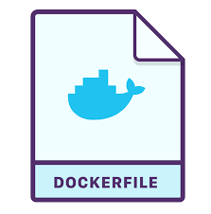
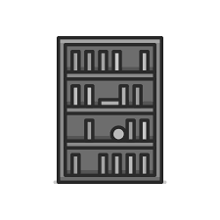
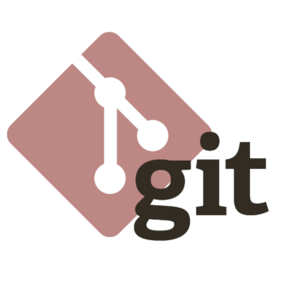
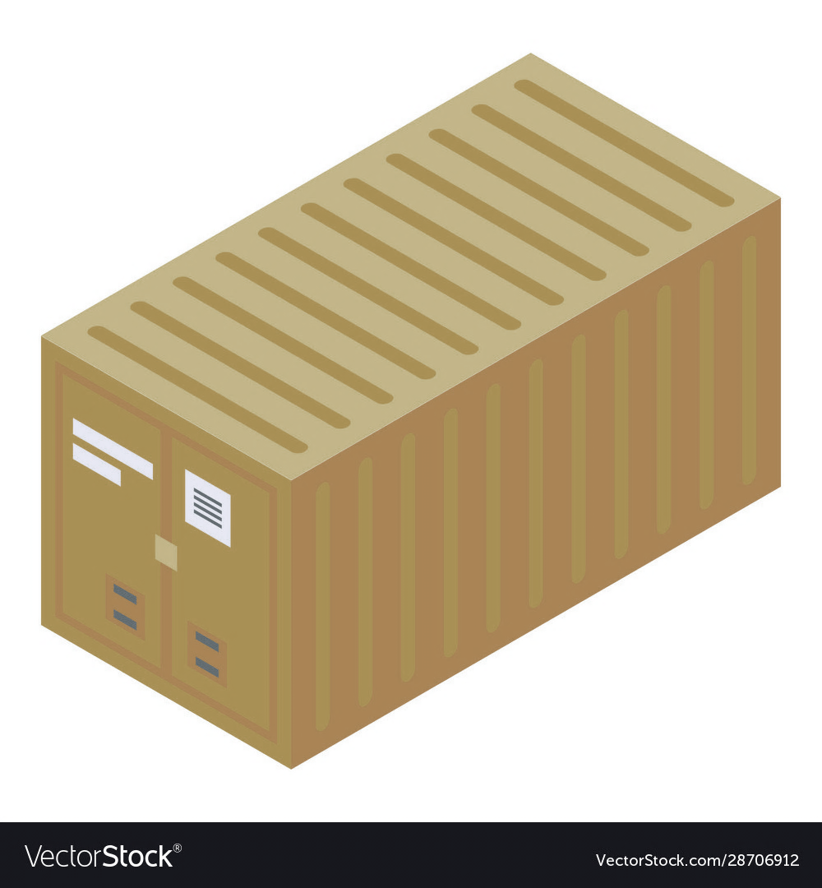

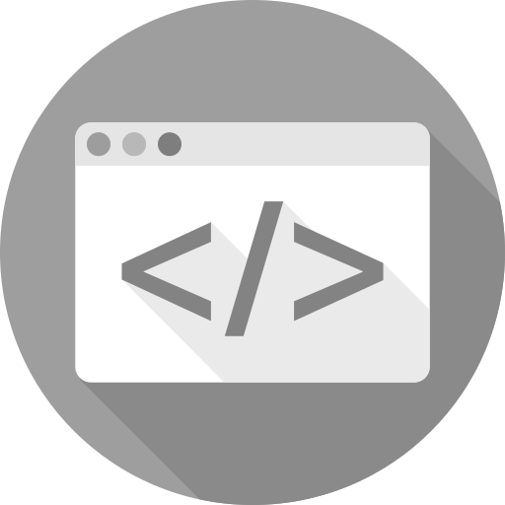
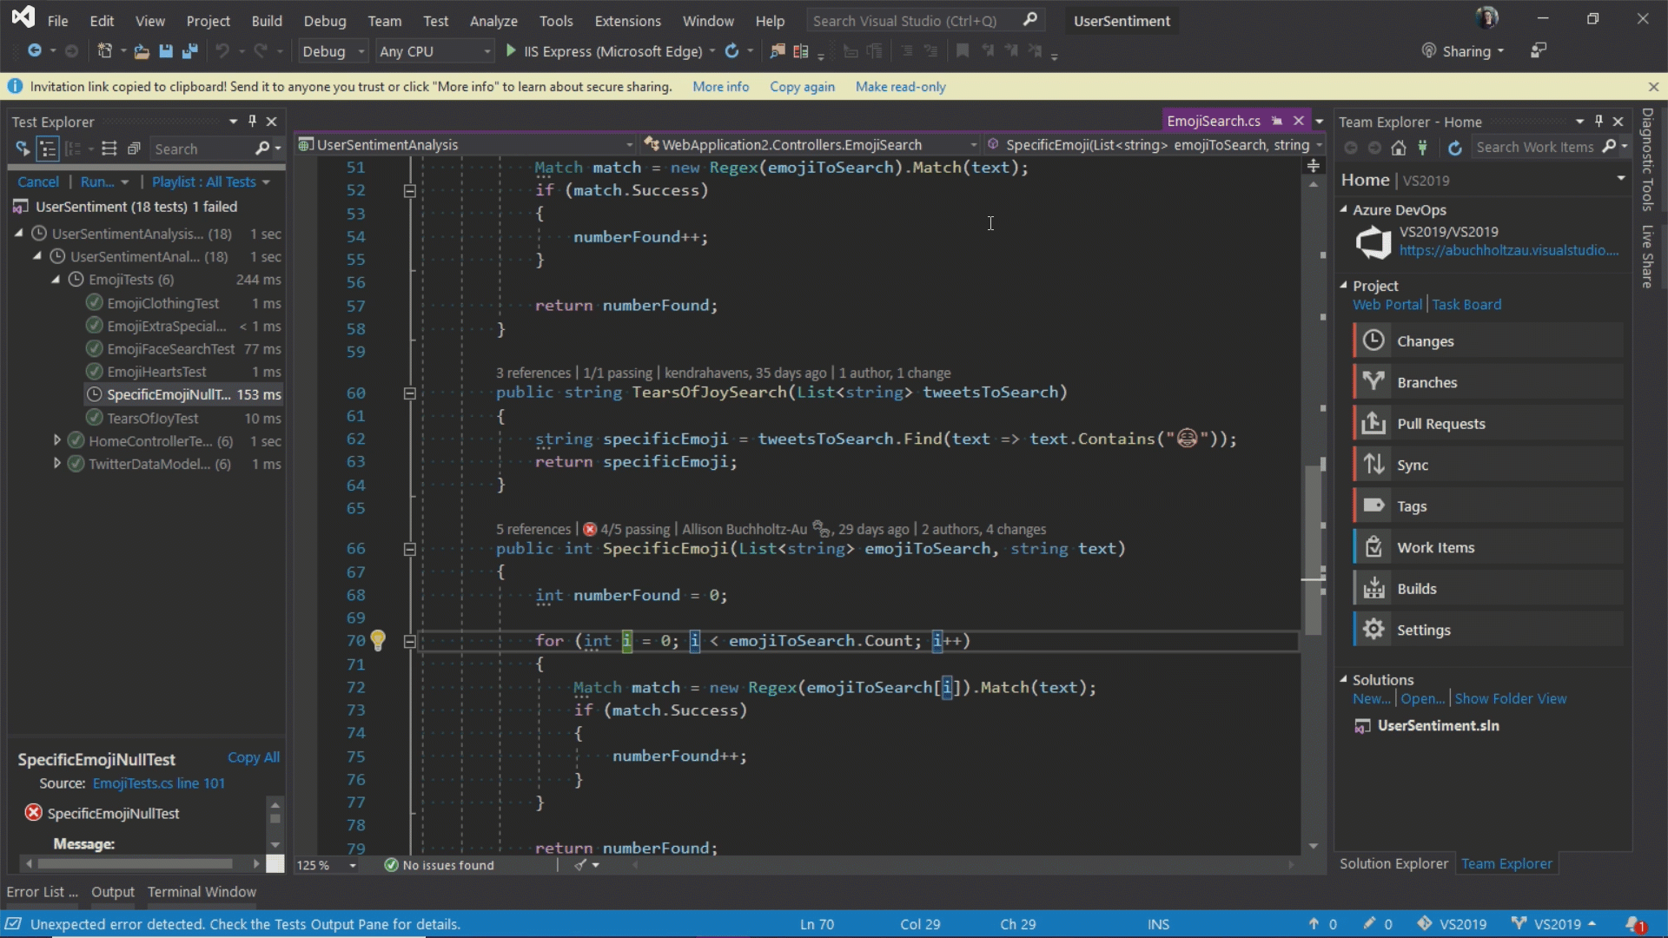
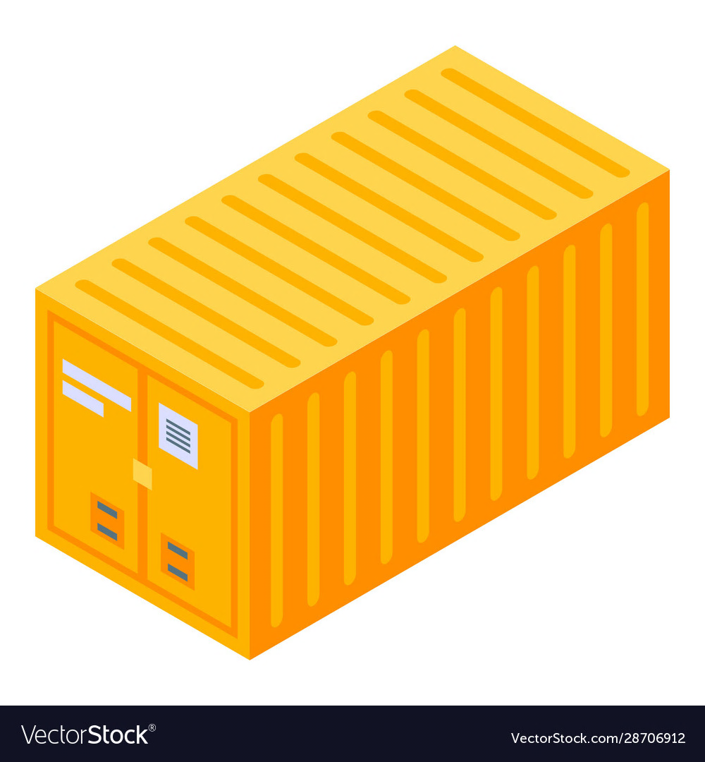
Docker workflow followed in lab
Registry
2. build
2. pull
Image
1. push
3. run
Container
Your pc
* More to come in the next classes…

Slide 41
Comparison (1/2)
Feature | Virtual machine | Container
Isolation
Provides complete isolation from the host operating system and other VMs.
This is useful when a strong security boundary is critical. ☺
Typically provides lightweight isolation from the host and other containers, but doesn't provide a strong security boundary as a VM ☹
Operating system
Runs a complete operating system including the kernel, so requiring more system resources. ☹
CPU, memory, and storage.
Runs the user mode portion of an operating system, and can be tailored to contain just the needed services for your app. ☺
Uses fewer system resources.
Guest compatibility
Runs just about any operating system inside the virtual machine ☺
Runs on the same operating system version as the host (but its usually fine). ☺

Slide 42
Comparison (2/2)
Feature | Virtual machine | Container
Deployment
Uses a Hypervisor
Uses an OS-level virtualisation method, e.g., Docker
Persistent storage
Use a virtual hard disk for local storage or a network file share for storage shared by multiple servers ☺
Use union file systems for local storage for a single node, or a network file share for storage shared by multiple nodes or servers ☺
Load balancing
Virtual machine load balancing moves running VMs to other servers in a failover cluster. ☺
Containers themselves don't move; instead an orchestrator can automatically start or stop containers on cluster nodes to manage changes in load and availability. ☺
Fault tolerance
VMs can fail over to another server in a cluster, the VM's operating system restarts on the new server (takes time). ☺
If a cluster node fails, any containers running on it are rapidly recreated by the orchestrator on another cluster node. ☺

Slide 43
Containers in VMs
VM 1
VM 2
Container 1
Container 2
Container 3
The major concerns with running containers on bare metal servers is security:
Containers make use of the operating system kernel and libraries, so could potentially represent a better opportunity for an attack.
The optimal deployment may be a combination of the two technologies.
Deploying a container inside a VM improve isolation and portability
VMs can be moved between different platforms (but this is not a trivial task).
App₁
App₂
App₃
App₄
Bins/Libs
Bins/Libs
Bins/Libs
Docker daemon
Docker daemon
Guest OS
Guest OS
Hypervisor (type 2)
Hypervisor (type 1)
Host OS
Server
* Example of 2 VMs that host 3 containers in one bare metal server

Slide 44
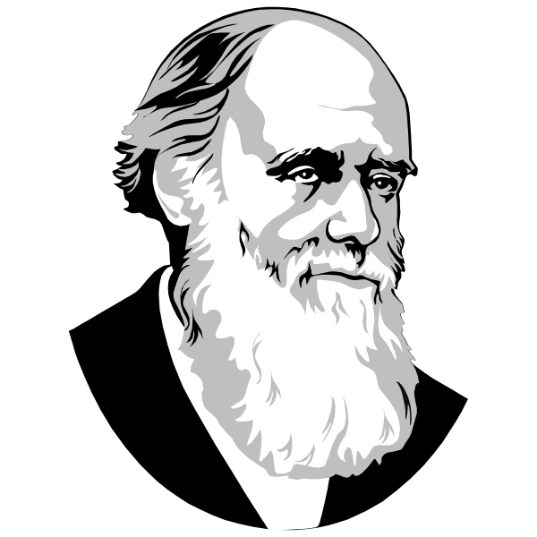
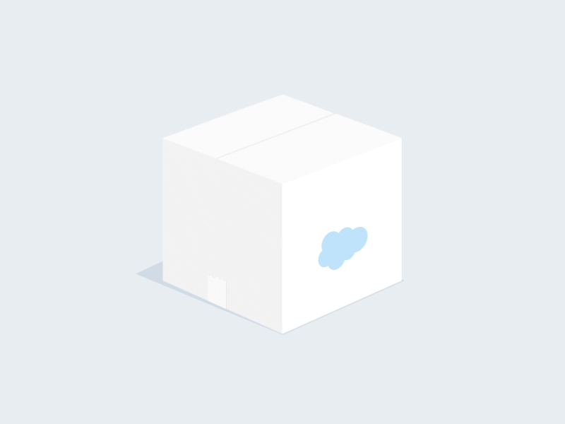
Thank you!
Quote of the day:
“It is not the strongest of the species that survive, nor the most intelligent, but the one most responsive to change.”
Charles Darwin
Lab sessions starts soon!

Slide 45
Containerising apps with Docker

Slide 46
What is Docker?
Docker is a set of platform as a service products that uses OS-level virtualization to deliver software in packages called containers.
A self-contained small space to run your code, including:
Your code (node.js)
Configuration files (.env, package.json, modules etc.)
Processes (running version of your node.js app)
Networking (allow remote connections on certain ports e.g. 3000)
Dependencies (express, nodemon, mongoose, body-parser, etc.)
Just enough of your OS to run your code ☺

Slide 47
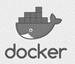
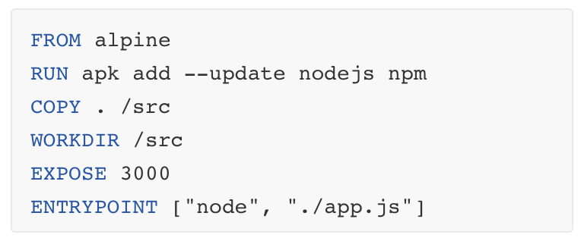
Docker deployment in lab
Docker file
build
Image
run
Container
OS (alpine)
Software (node)
Applications
GCP VM /lab5-test-app
pull
GitHub repo
* Alpine is a Linux distribution. The image is only 5 MB in size and has access to a package repository. Alpine is not an Ubuntu OS!
push
Node.js app

Slide 48
Docker CLI, basic commands
docker build # Build an image from a Dockerfile
docker images # List all images on a Docker host
docker run # Run an image
docker ps # List all running and stopped instances
docker stop # Stop a running instance
docker rm # Remove an instance
docker rmi # Remove an image
Docker docs

Slide 49
Demo: Building a GKE cluster

Slide 50
Running Docker
Intro to Docker
Create a VM and install Docker
Containerising an application
Building Docker images and pushing code to GitHub

Slide 51
Practical Session

Slide 52

Deployment using Docker
Run the tutorials:
Introduction to Docker
Docker Command Line tool
Using Docker to deploy and run containers
Exercises:
Deploy your Docker containers using GitHub

